Slide 1



COVO TOUCHLESS DOORBELL
Group B4 -SUB ZERO
Prateek Sharawat (102003428)
Abhishek Vohra (102003439)
Aditya Singh Rathore (102003424)
Aradhya Singhi (102003387)
Deepankar Varma (102003431)
Sarisha Aggarwal (102003445)

Slide 2

About
This project is based on the ideology that prevention is better than cure. We have made a completely contactless doorbell system so as to minimize the spread of COVID-19.

Slide 3

Salient Features
1. Totally contactless
2. Fast And Reliable Temperature Detection
3. Different sounds during the operation for better understanding
4. LCD Display for makes it more user friendly
5. Compact in size and a totally new concept in the market
6. Use of NeoPixel Strips makes it more attractive

Slide 4
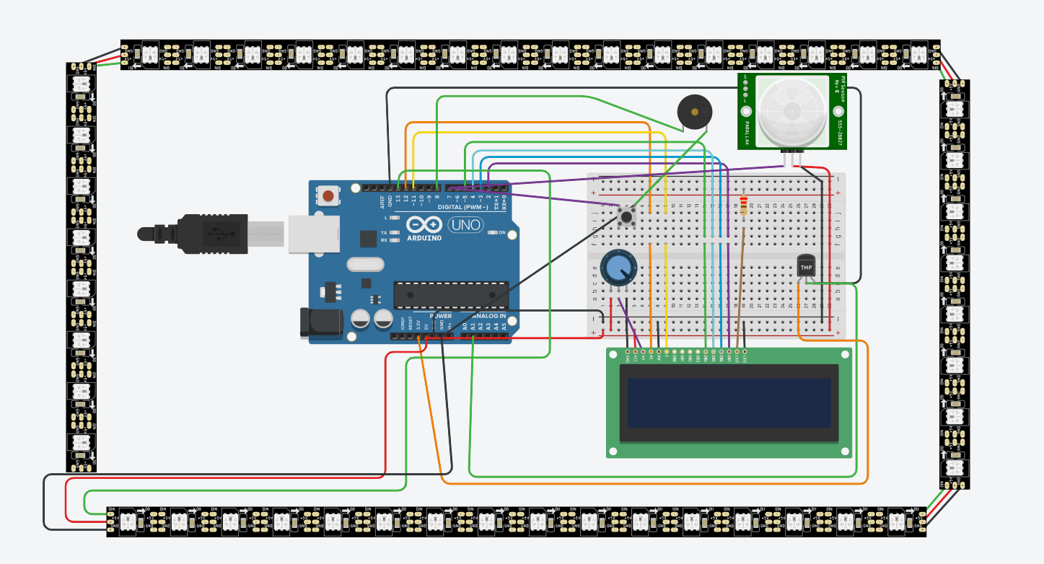
Circuit Diagram

Slide 5
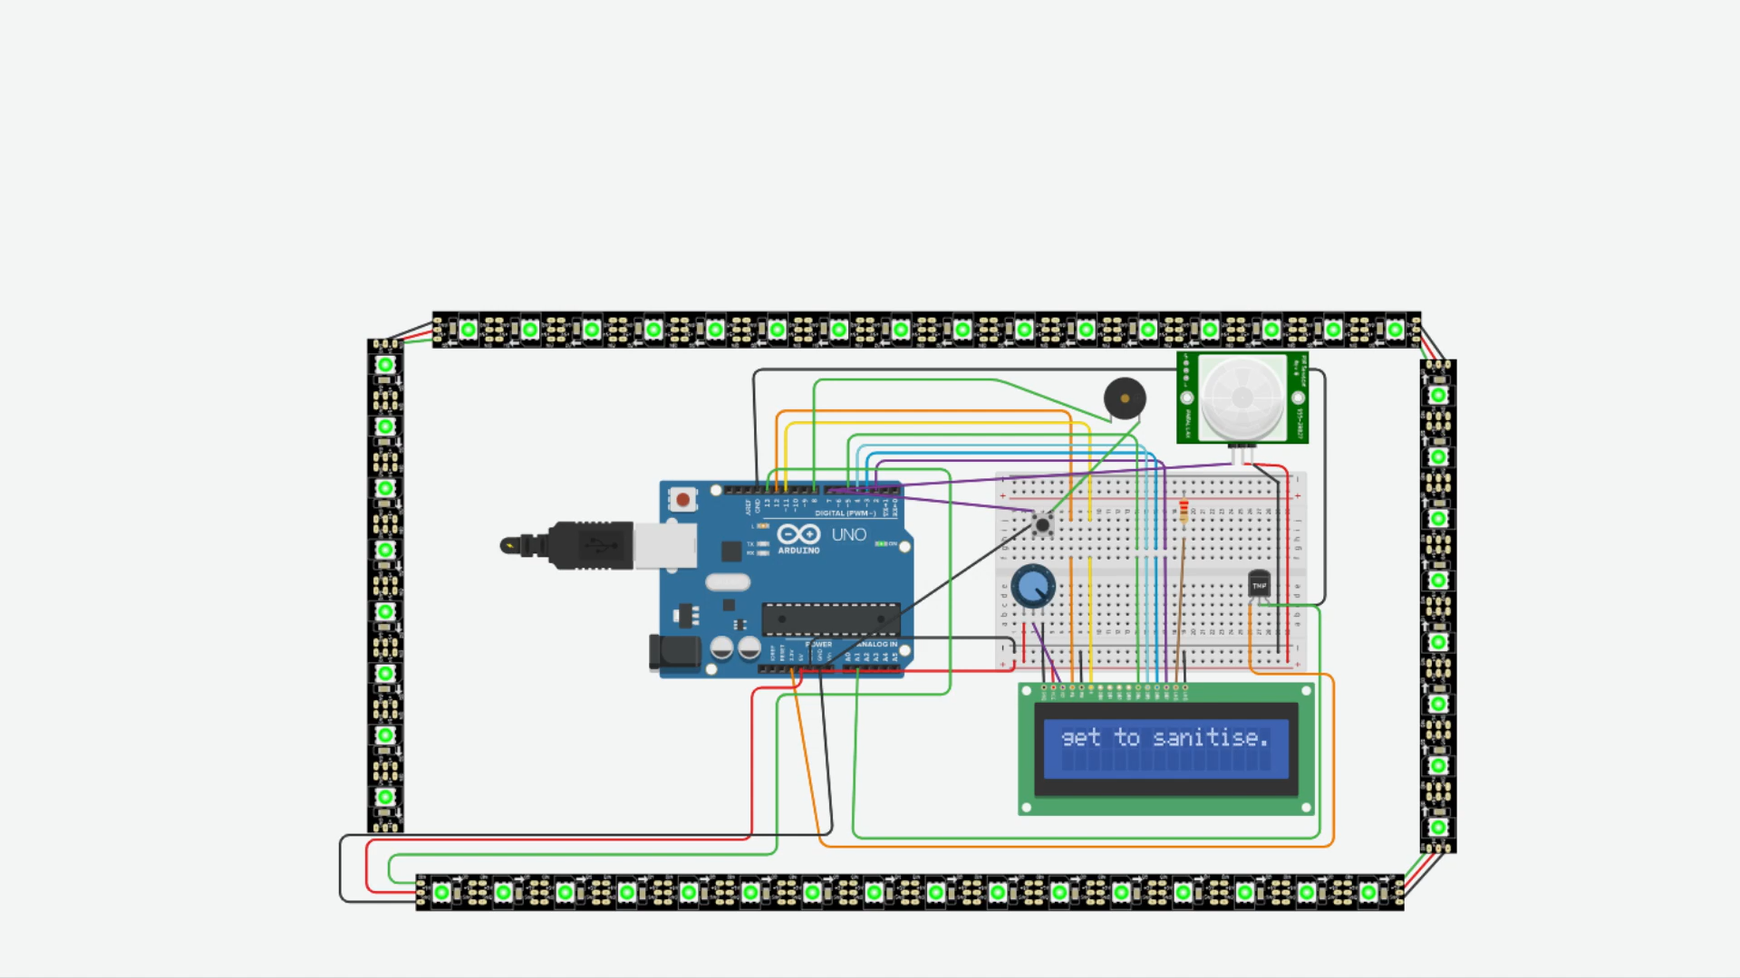
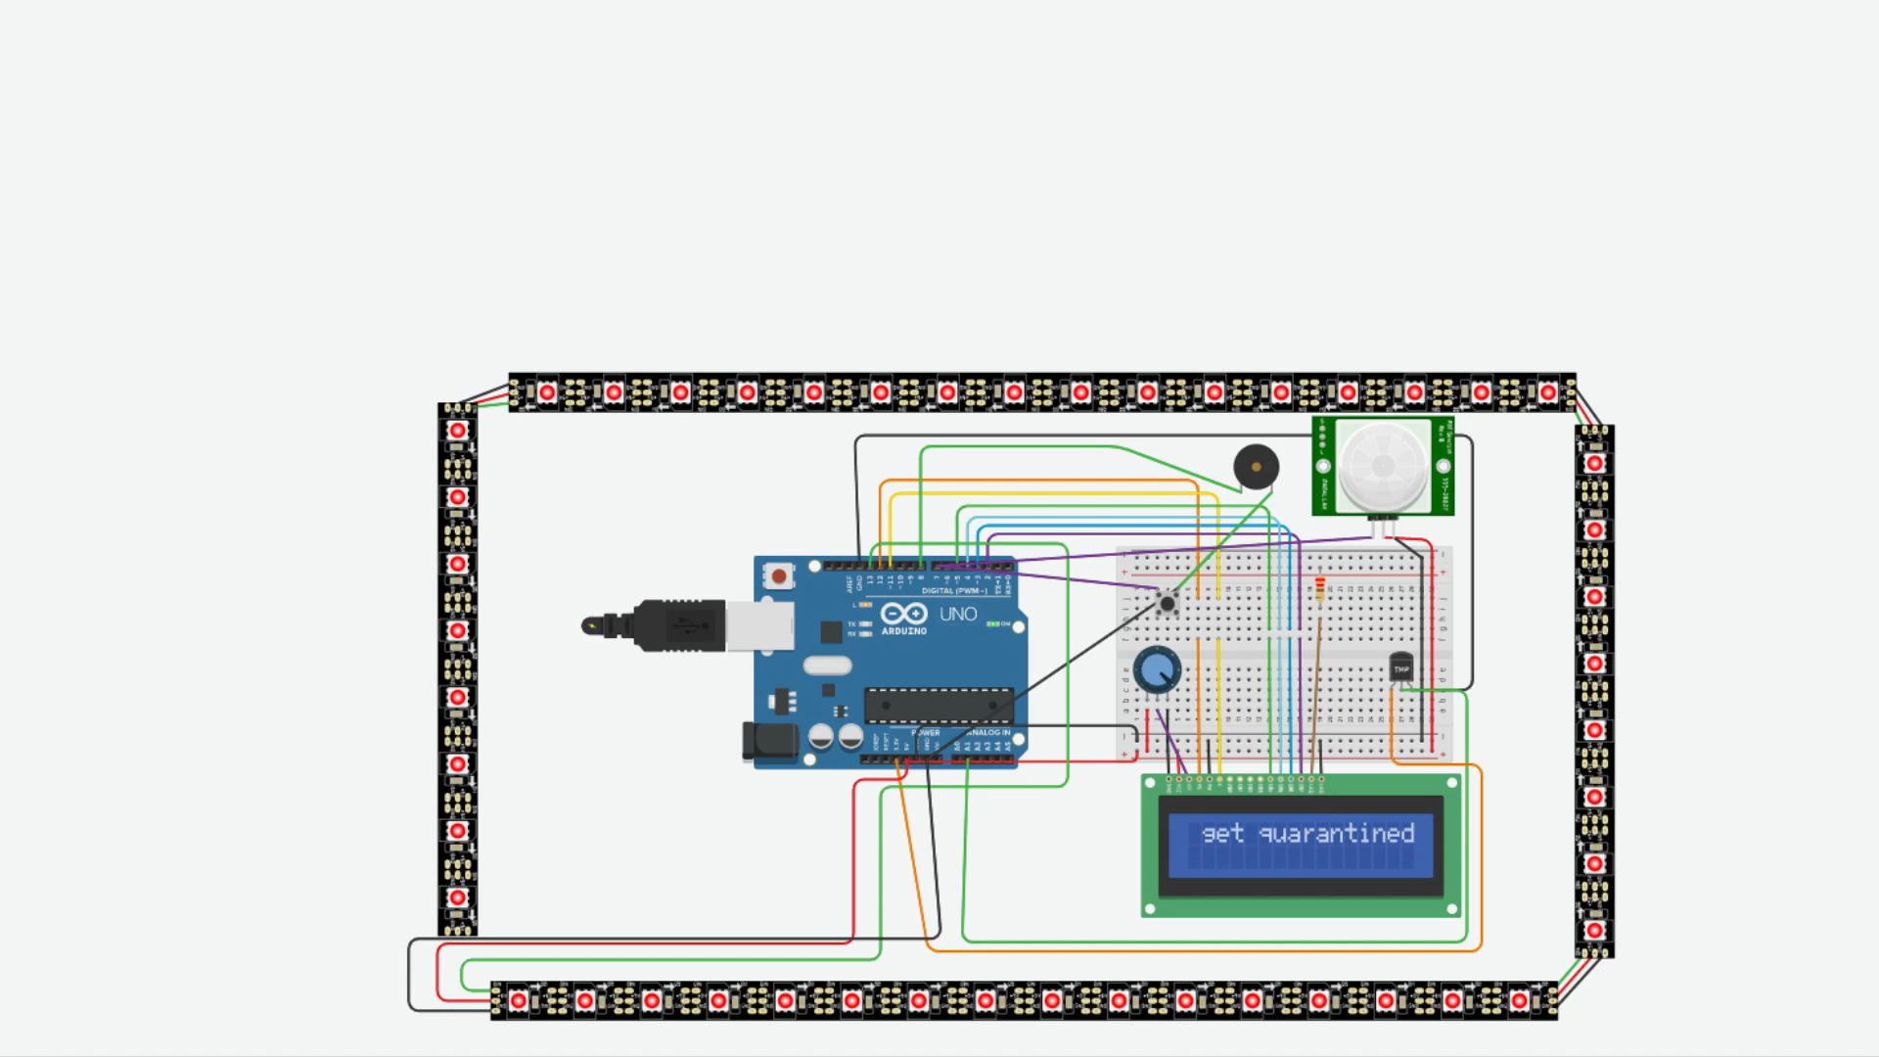
Temperature Detection
Red lights glow as the temperature is beyond
the permissible level.
Green lights glow as the temperature is within
the permissible level.

Slide 6

Demonstration Video Links
YouTube Video Link :- https://youtu.be/lZjHSfEq4Eg
TINKERCAD Project Link :- https://www.tinkercad.com/things/6erPyzM3jKZ-gold-challenge-covo-touchl
ess-doorbell/editel?sharecode=8G0ZXJ-4R6UrEd9HVE2e_MeCdEHWYOiqMNLDPGWedek

